Slide 1
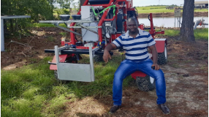
AGE 310: Instrumentation and Measurements
Lecture 13: Agricultural Drones (UAVs)
Instructor: Dr. Kadeghe Fue
Electronics and Precision Agriculture Lab (EPA Lab)
Sokoine University of Agriculture (SUA)

Slide 2


Recap & Objectives
Recap: Lecture 12
Lecture 13 Objectives
We introduced Agricultural Robotics, focusing on ground-based systems (UGVs) and kinematic principles.
Classify **UAVs**: Fixed-wing vs. Multi-rotor.
Analyze Key Components (Flight Controller, ESC, GPS).
Explore Sensors: RGB, Multispectral, Thermal, LiDAR.
Understand **TCAA Regulations** for Tanzania.
Case Studies: Sugarcane Ripening & Quelea Bird Control.

Slide 3







Why Drones in Tanzanian Agriculture?
Drones bridge the gap between satellite imagery (low res, cloud cover) and ground scouting (slow, labor intensive).
Accessibility
Timeliness
Precision Application
Can reach inaccessible areas like muddy rice paddies or tall sugarcane fields easily.
Data is available on-demand. No waiting for satellite passes.
Spraying pesticides only where needed (Spot Spraying), saving up to 30% on chemicals.

Slide 4

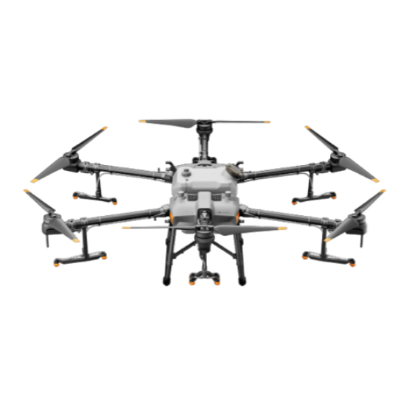
1. Multi-Rotor Drones
Characteristics
Uses propellers (4, 6, or 8) to generate lift. Vertical Take-Off and Landing (VTOL).
Pros: Easy to fly, can hover, high payload (good for spraying).
Cons: Short flight time (15-30 mins).
Example: DJI Agras T30 (shown).
Standard for spraying Cashew and Coffee in Mbeya/Mtwara.

Slide 5

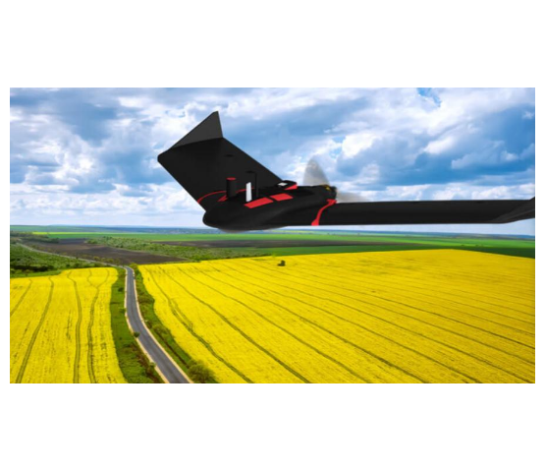
2. Fixed-Wing Drones
Characteristics
Looks like a plane. Uses wings for lift and a motor for forward thrust.
Pros: Long flight time (1hr+), covers huge areas (Mapping).
Cons: Cannot hover, needs space to land/takeoff.
Example: senseFly eBee.
Ideal for mapping vast Sugarcane plantations like Kilombero or Mtibwa.

Slide 6


Anatomy of a Drone
Flight Controller (FC)
ESC (Electronic Speed Controller)
The "Brain". Contains the IMU (Gyro/Accel) and PID algorithms to keep the drone stable.
The "Muscle Interface". Converts signals from the FC into high-current 3-phase power for the Brushless Motors.
GNSS/RTK
Telemetry
Global Navigation Satellite System. RTK (Real-Time Kinematic) provides cm-level accuracy for automated flight paths.
Radio link (915MHz or 2.4GHz) sending data back to the Ground Control Station (Laptop/Tablet).

Slide 7
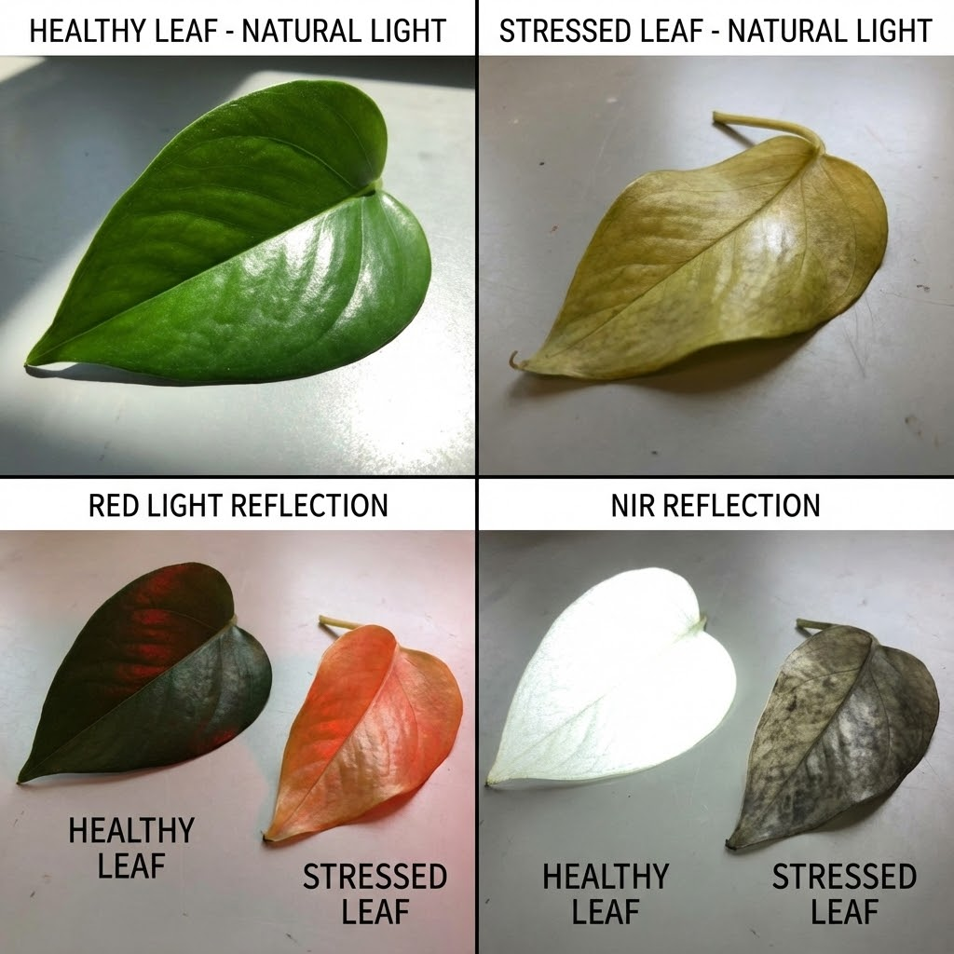
Sensors: Beyond the Visible
Multispectral Cameras
Plants reflect light differently depending on their health.
These cameras capture distinct bands: Red, Green, Blue, Red-Edge, and Near Infrared (NIR).
Healthy chlorophyll absorbs Red and reflects NIR. Stressed plants reflect less NIR.

Slide 8
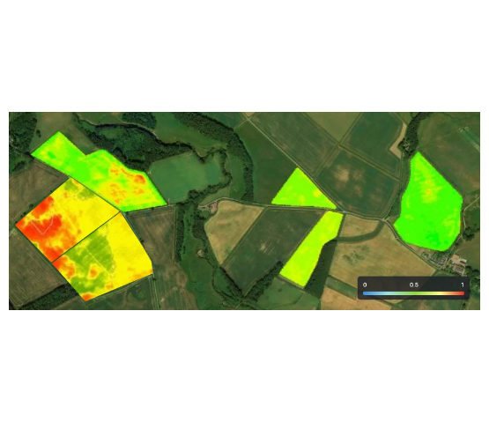


NDVI: The Health Map
Normalized Difference Vegetation Index
Values range from -1 to +1.
> 0.6: Healthy, dense canopy (Green).
0.2 - 0.4: Stressed crops or sparse vegetation (Yellow).
< 0.1: Bare soil or water (Red).

Slide 9

Applications in Tanzania
1. Precision Spraying
2. Crop Scouting
Using drones like the DJI Agras for applying pesticides in Cashew Nut trees (difficult to reach tops) or ripeners in Sugarcane.
Flying over Maize fields to detect Fall Armyworm damage early.
Benefits: Faster than walking; detects hotspots before they spread.
Benefits: Reduces chemical use, zero soil compaction.

Slide 10
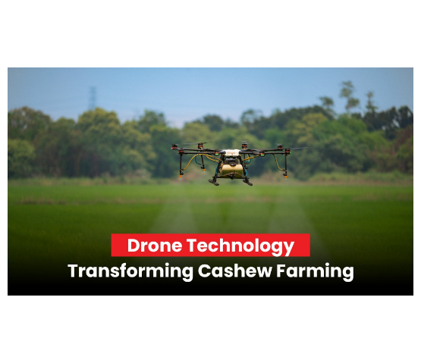
Research at SUA: Quelea Control
The Quelea Bird Menace
Quelea birds destroy tons of rice/wheat. Traditional control involves dynamite or poison (harmful to environment).
EPA Lab Innovation
We are researching the use of drones equipped with Bio-Acoustic speakers (predator sounds) to scare birds away autonomously.
An eco-friendly alternative developed right here at SUA.

Slide 11
Regulations: Flying Legally
TCAA Regulations
Tanzania Civil Aviation Authority (2018 Regulations)
Safety and Security come first.

Slide 12
Key TCAA Rules for Operators
Registration & Permits
Flight Rules
Registration: Mandatory for ALL drones (~$100 fee).
VLOS: Visual Line of Sight must be maintained.
Import Permit: Must be obtained before buying/importing the drone.
Altitude: Max 400ft (120m).
No-Fly Zones: Airports (3km radius), National Parks (Strict!), and over crowds.
Weight Limit: Drones > 7kg require special Ministry of Defense clearance.

Slide 13
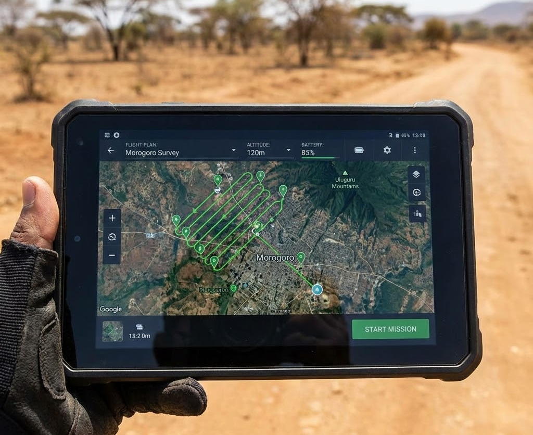
Mission Planning Software
Automation
We don't fly agricultural drones manually with joysticks.
We use software (e.g., Pix4D, DJI Pilot) to plan the path.
1.
Draw the field boundary.
2.
Set overlap (e.g., 70%).
3.
Set altitude.
4.
Drone calculates the "Lawnmower" path and flies autonomously.

Slide 14




Challenges to Adoption
Battery Life
Regulation
Data Overload
Multi-rotors last only 20 mins. Large fields require many batteries and field charging (generators).
Getting permits in Tanzania can be slow. Heavy drones (>7kg) for spraying face strict scrutiny.
One flight generates Gigabytes of images. Processing requires powerful computers and internet.

Slide 15

Discussion
End of Lecture 13
Assignment: Visit the EPA Lab website (or physical lab). Identify one drone model we have and list its sensor payload.
Dr. Kadeghe Fue | AGE 310 | SUA

